Slide 1

Notes:
Source: GCSE Media Studies for AQA, Heinemann (2004), uploaded as Year 11 Media Design.pdf, printed pages 34–39. Classroom adaptation. Generated imagery is illustrative, including historical scenes and programme examples. UK digital television date corrected to 1998: https://publications.parliament.uk/pa/cm200506/cmselect/cmcumeds/650/5121308.htm. Peak-time hours and programme openings refer to historical examples.

Slide 2
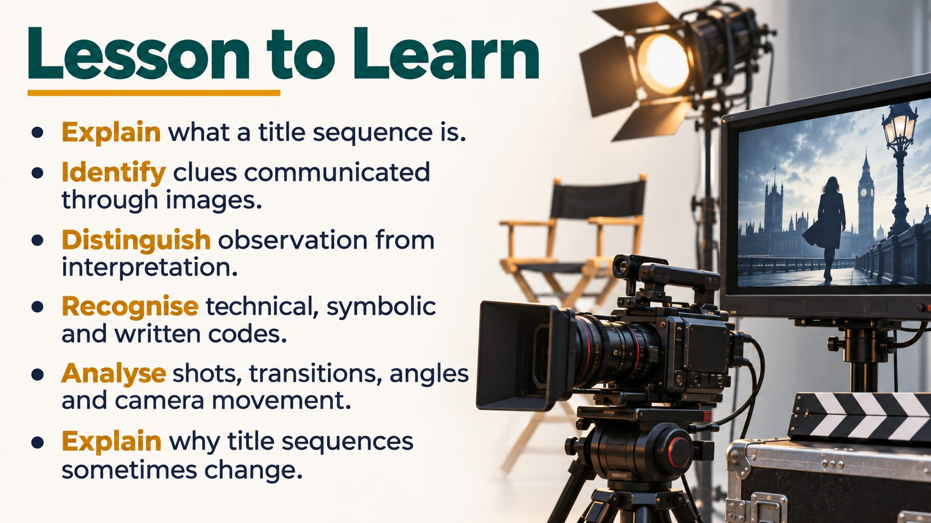
Notes:
Source: GCSE Media Studies for AQA, Heinemann (2004), uploaded as Year 11 Media Design.pdf, printed pages 34–39. Classroom adaptation. Generated imagery is illustrative, including historical scenes and programme examples. UK digital television date corrected to 1998: https://publications.parliament.uk/pa/cm200506/cmselect/cmcumeds/650/5121308.htm. Peak-time hours and programme openings refer to historical examples.

Slide 3
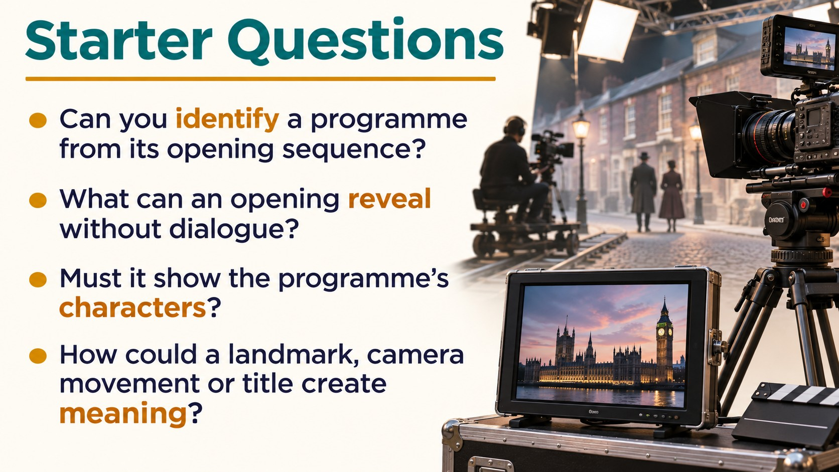
Notes:
Source: GCSE Media Studies for AQA, Heinemann (2004), uploaded as Year 11 Media Design.pdf, printed pages 34–39. Classroom adaptation. Generated imagery is illustrative, including historical scenes and programme examples. UK digital television date corrected to 1998: https://publications.parliament.uk/pa/cm200506/cmselect/cmcumeds/650/5121308.htm. Peak-time hours and programme openings refer to historical examples.

Slide 4
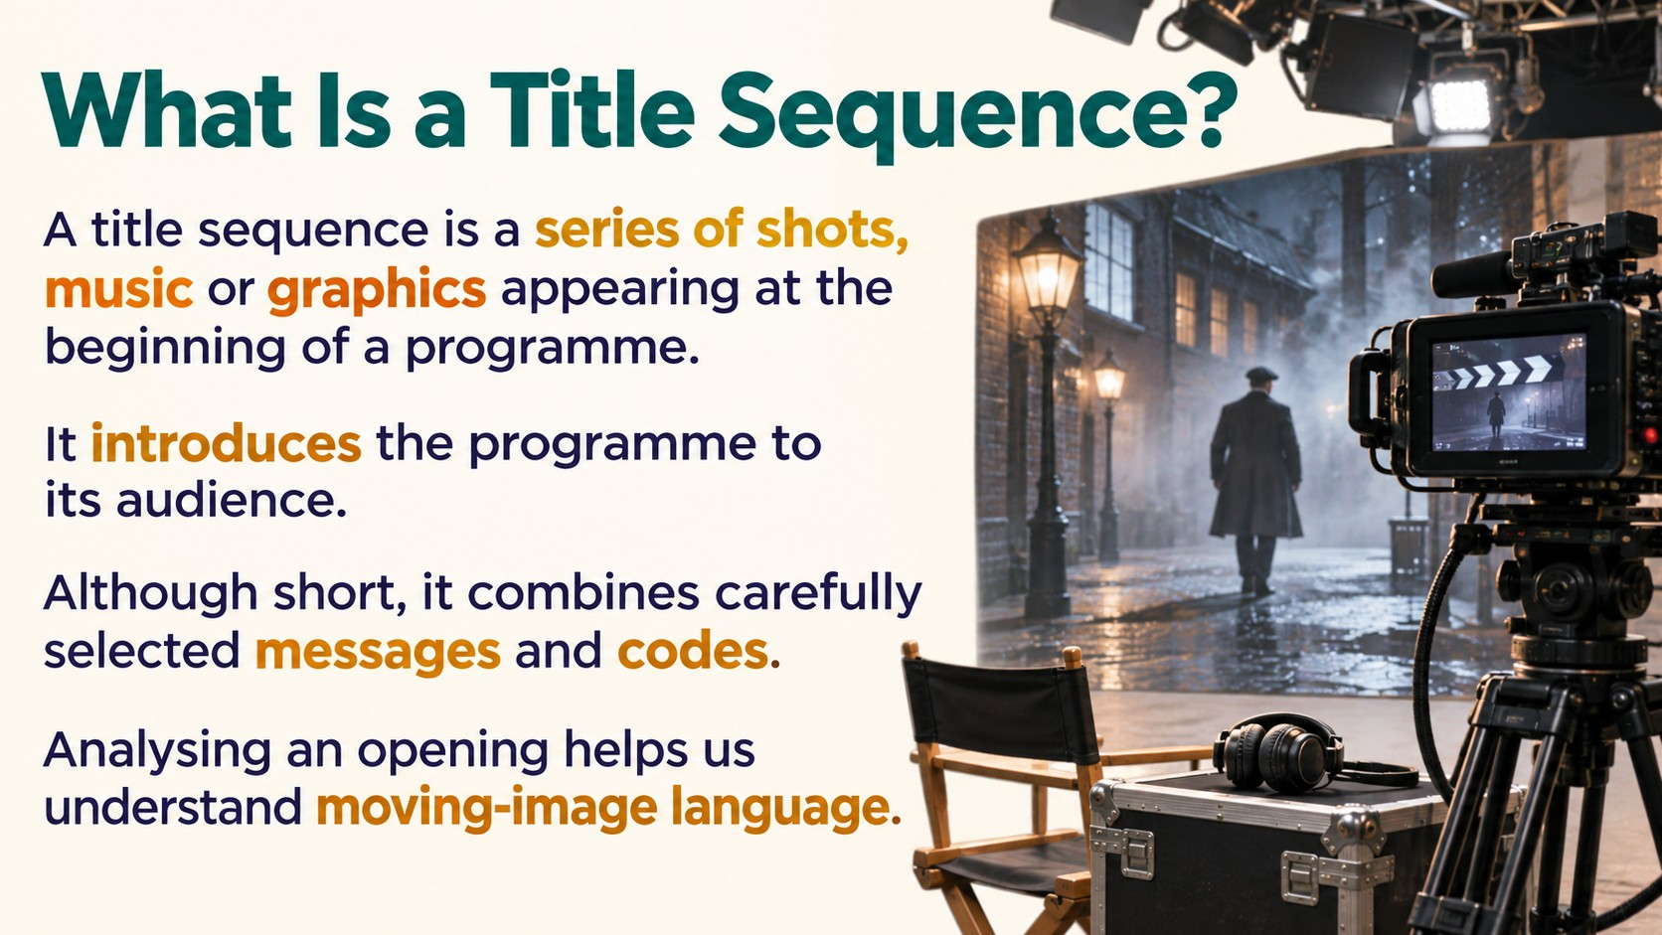
Notes:
Source: GCSE Media Studies for AQA, Heinemann (2004), uploaded as Year 11 Media Design.pdf, printed pages 34–39. Classroom adaptation. Generated imagery is illustrative, including historical scenes and programme examples. UK digital television date corrected to 1998: https://publications.parliament.uk/pa/cm200506/cmselect/cmcumeds/650/5121308.htm. Peak-time hours and programme openings refer to historical examples.

Slide 5
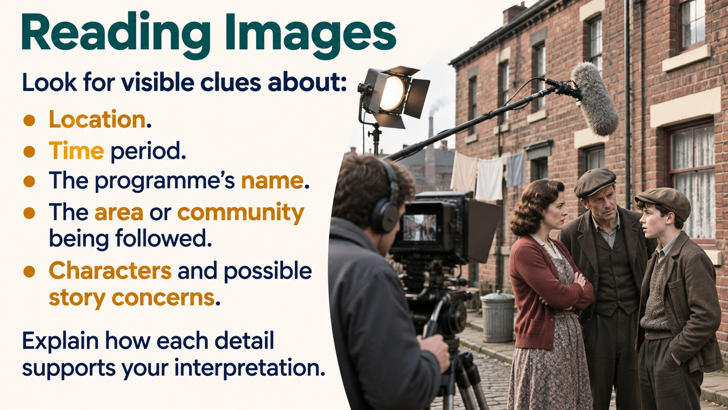
Notes:
Source: GCSE Media Studies for AQA, Heinemann (2004), uploaded as Year 11 Media Design.pdf, printed pages 34–39. Classroom adaptation. Generated imagery is illustrative, including historical scenes and programme examples. UK digital television date corrected to 1998: https://publications.parliament.uk/pa/cm200506/cmselect/cmcumeds/650/5121308.htm. Peak-time hours and programme openings refer to historical examples.

Slide 6
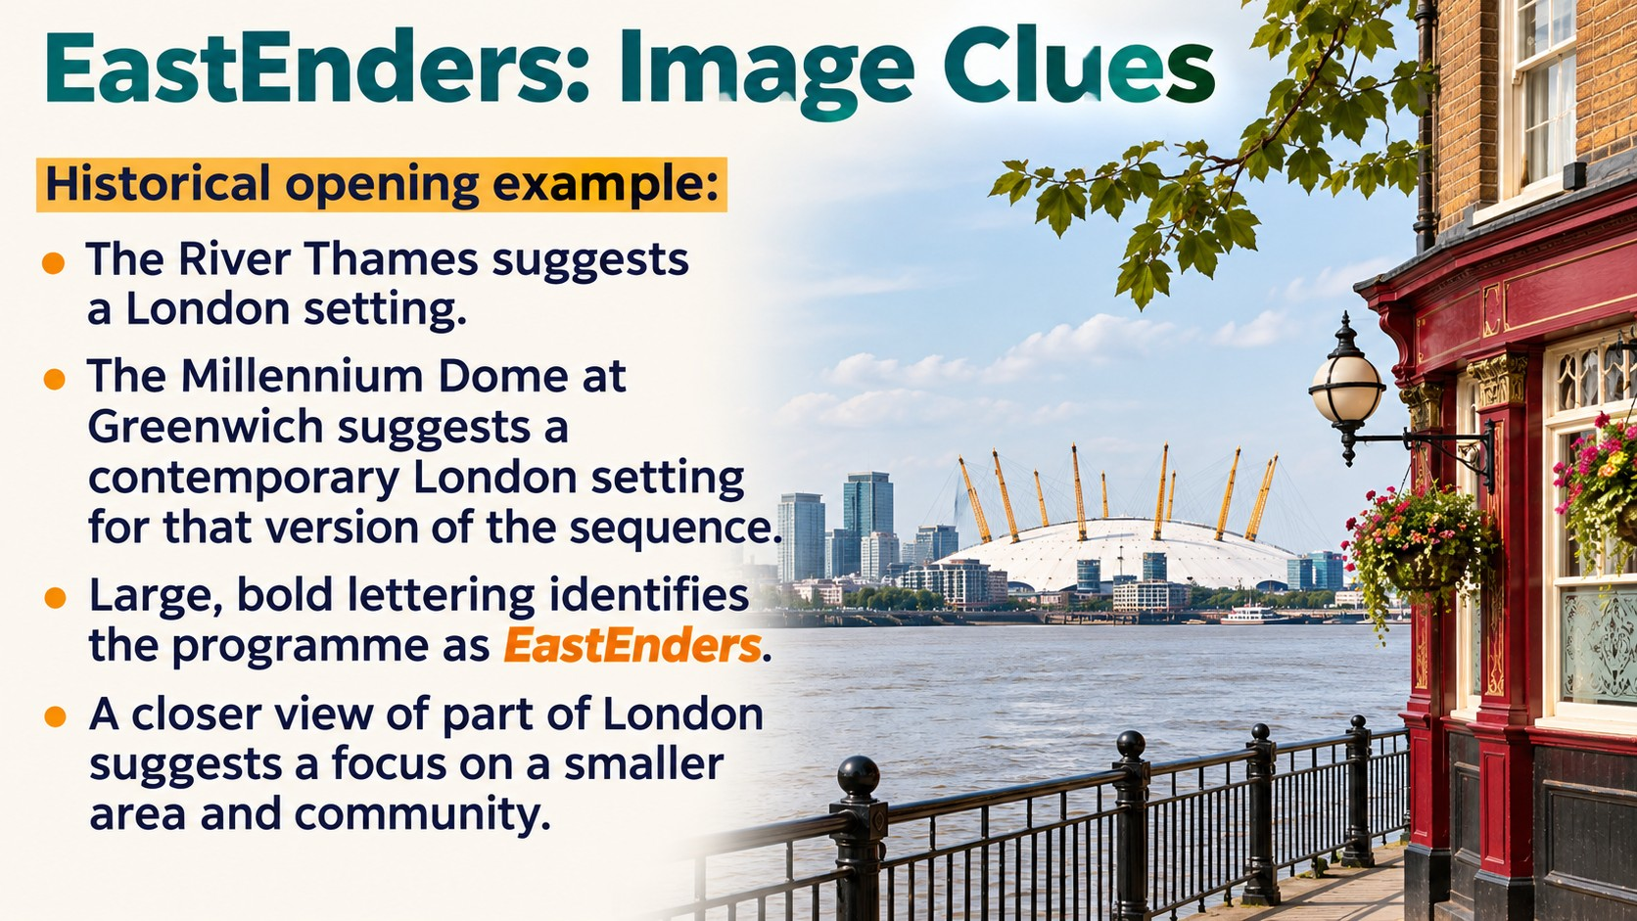
Notes:
Source: GCSE Media Studies for AQA, Heinemann (2004), uploaded as Year 11 Media Design.pdf, printed pages 34–39. Classroom adaptation. Generated imagery is illustrative, including historical scenes and programme examples. UK digital television date corrected to 1998: https://publications.parliament.uk/pa/cm200506/cmselect/cmcumeds/650/5121308.htm. Peak-time hours and programme openings refer to historical examples.

Slide 7
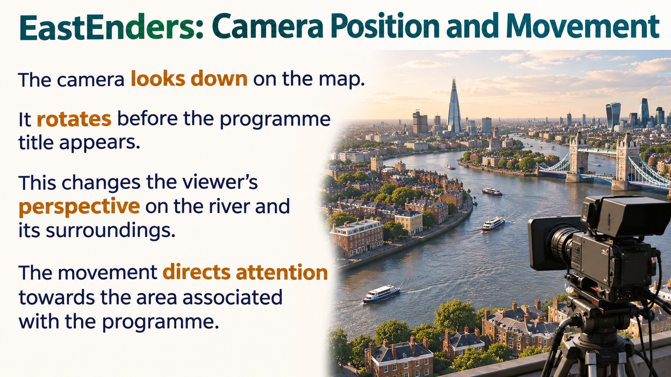
Notes:
Source: GCSE Media Studies for AQA, Heinemann (2004), uploaded as Year 11 Media Design.pdf, printed pages 34–39. Classroom adaptation. Generated imagery is illustrative, including historical scenes and programme examples. UK digital television date corrected to 1998: https://publications.parliament.uk/pa/cm200506/cmselect/cmcumeds/650/5121308.htm. Peak-time hours and programme openings refer to historical examples.

Slide 8

Notes:
Source: GCSE Media Studies for AQA, Heinemann (2004), uploaded as Year 11 Media Design.pdf, printed pages 34–39. Classroom adaptation. Generated imagery is illustrative, including historical scenes and programme examples. UK digital television date corrected to 1998: https://publications.parliament.uk/pa/cm200506/cmselect/cmcumeds/650/5121308.htm. Peak-time hours and programme openings refer to historical examples.

Slide 9
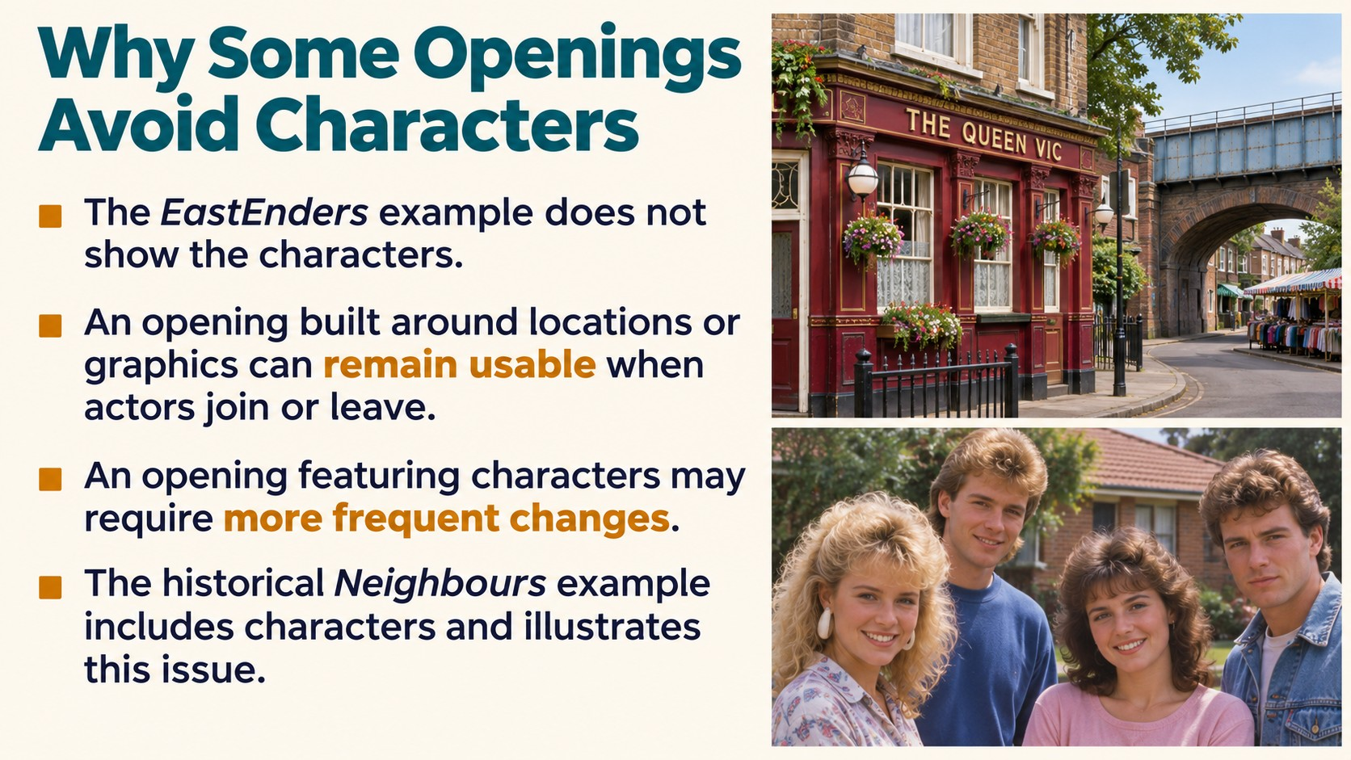
Notes:
Source: GCSE Media Studies for AQA, Heinemann (2004), uploaded as Year 11 Media Design.pdf, printed pages 34–39. Classroom adaptation. Generated imagery is illustrative, including historical scenes and programme examples. UK digital television date corrected to 1998: https://publications.parliament.uk/pa/cm200506/cmselect/cmcumeds/650/5121308.htm. Peak-time hours and programme openings refer to historical examples.

Slide 10
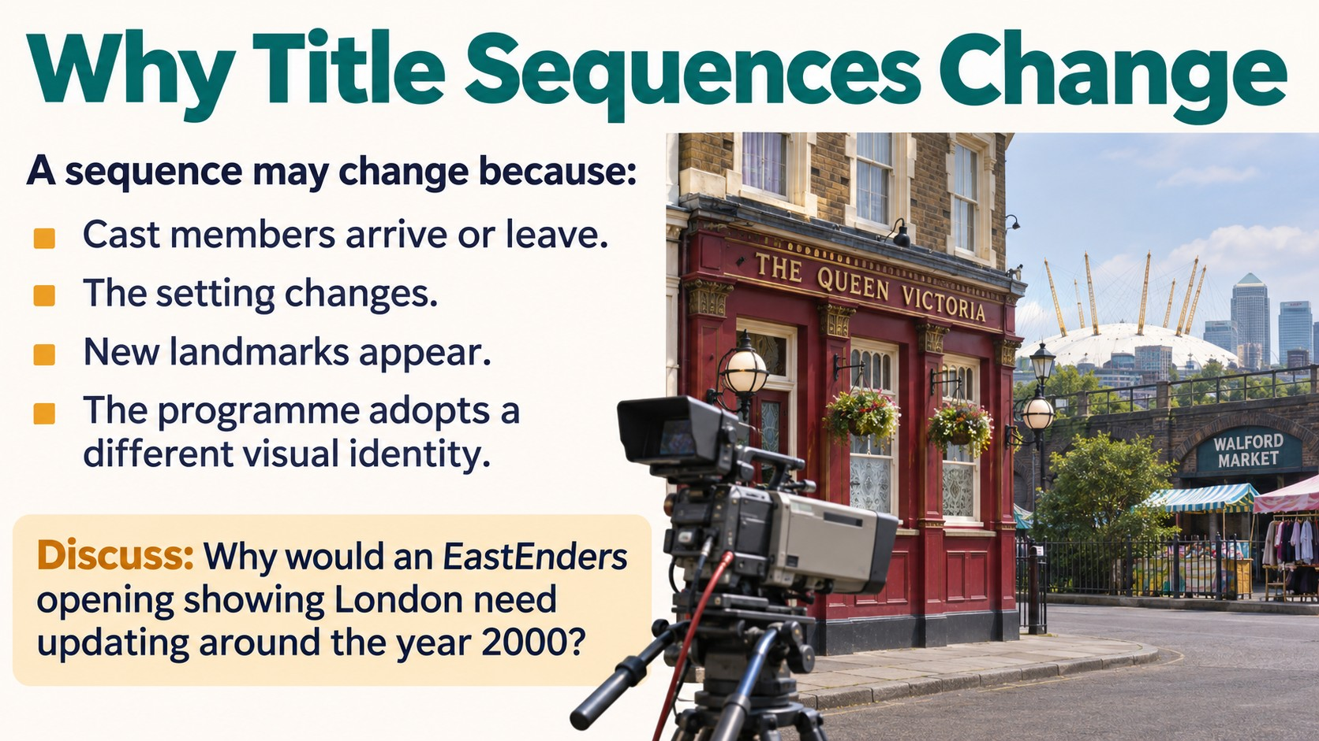
Notes:
Source: GCSE Media Studies for AQA, Heinemann (2004), uploaded as Year 11 Media Design.pdf, printed pages 34–39. Classroom adaptation. Generated imagery is illustrative, including historical scenes and programme examples. UK digital television date corrected to 1998: https://publications.parliament.uk/pa/cm200506/cmselect/cmcumeds/650/5121308.htm. Peak-time hours and programme openings refer to historical examples.

Slide 11
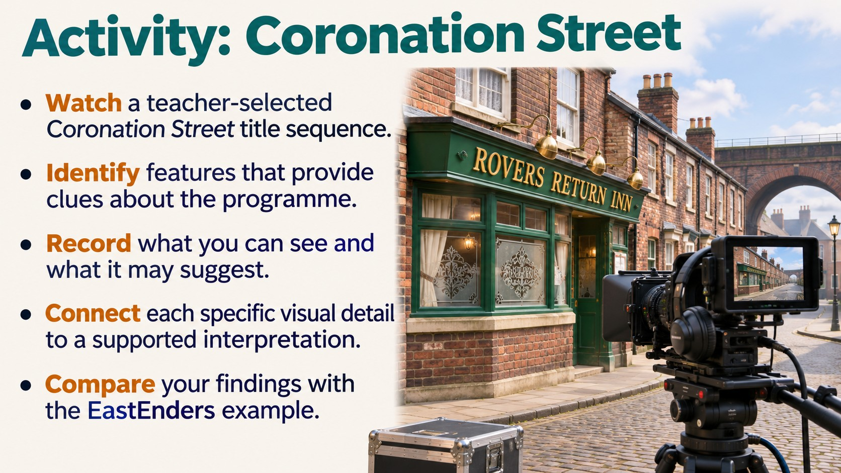
Notes:
Source: GCSE Media Studies for AQA, Heinemann (2004), uploaded as Year 11 Media Design.pdf, printed pages 34–39. Classroom adaptation. Generated imagery is illustrative, including historical scenes and programme examples. UK digital television date corrected to 1998: https://publications.parliament.uk/pa/cm200506/cmselect/cmcumeds/650/5121308.htm. Peak-time hours and programme openings refer to historical examples.

Slide 12
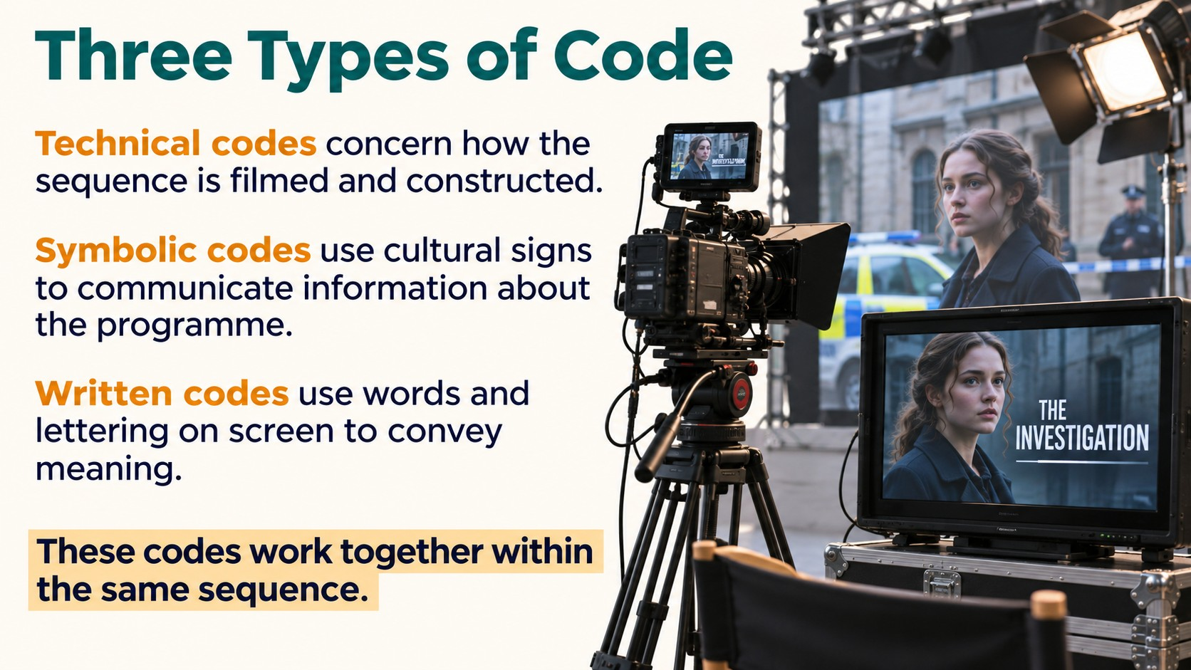
Notes:
Source: GCSE Media Studies for AQA, Heinemann (2004), uploaded as Year 11 Media Design.pdf, printed pages 34–39. Classroom adaptation. Generated imagery is illustrative, including historical scenes and programme examples. UK digital television date corrected to 1998: https://publications.parliament.uk/pa/cm200506/cmselect/cmcumeds/650/5121308.htm. Peak-time hours and programme openings refer to historical examples.

Slide 13
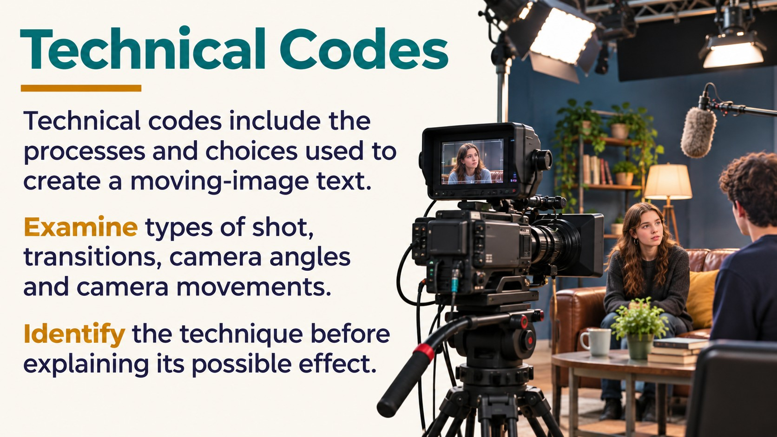
Notes:
Source: GCSE Media Studies for AQA, Heinemann (2004), uploaded as Year 11 Media Design.pdf, printed pages 34–39. Classroom adaptation. Generated imagery is illustrative, including historical scenes and programme examples. UK digital television date corrected to 1998: https://publications.parliament.uk/pa/cm200506/cmselect/cmcumeds/650/5121308.htm. Peak-time hours and programme openings refer to historical examples.

Slide 14
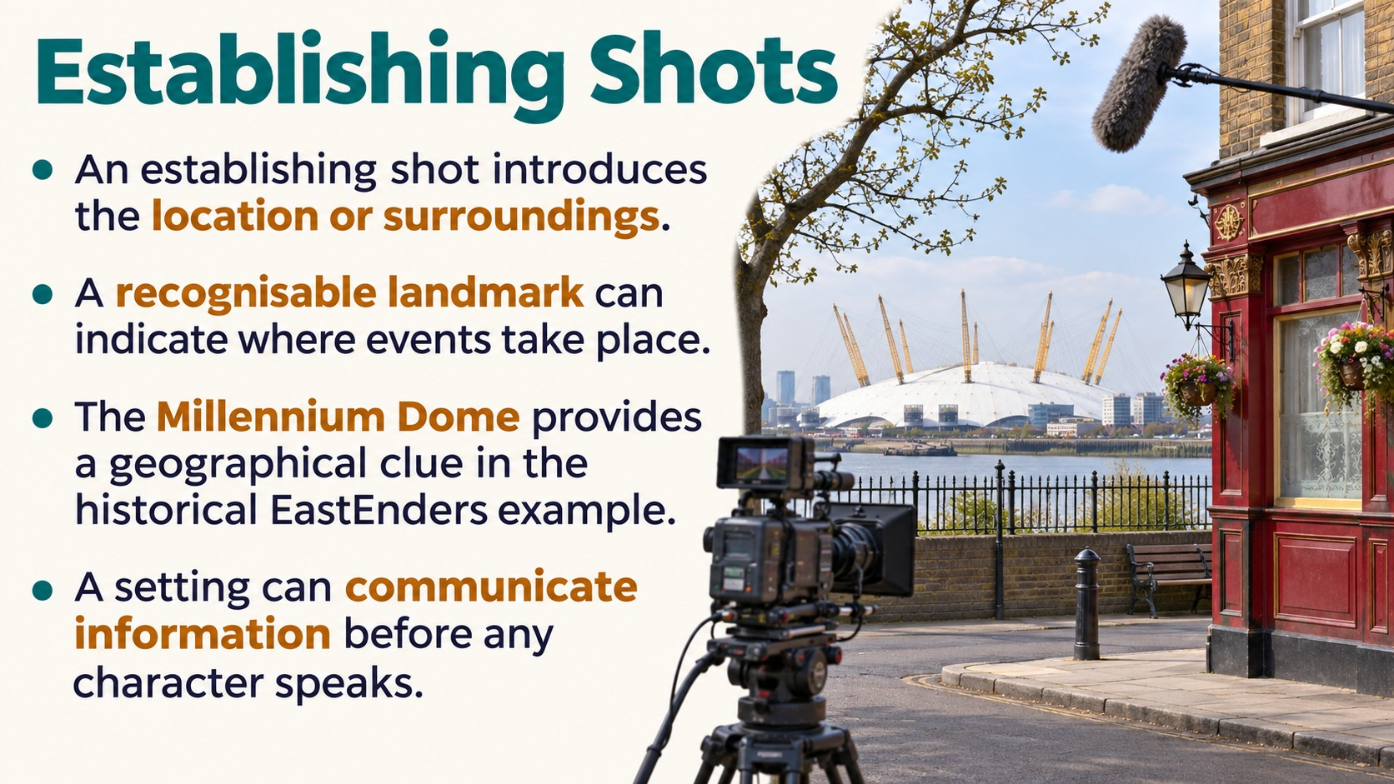
Notes:
Source: GCSE Media Studies for AQA, Heinemann (2004), uploaded as Year 11 Media Design.pdf, printed pages 34–39. Classroom adaptation. Generated imagery is illustrative, including historical scenes and programme examples. UK digital television date corrected to 1998: https://publications.parliament.uk/pa/cm200506/cmselect/cmcumeds/650/5121308.htm. Peak-time hours and programme openings refer to historical examples.

Slide 15
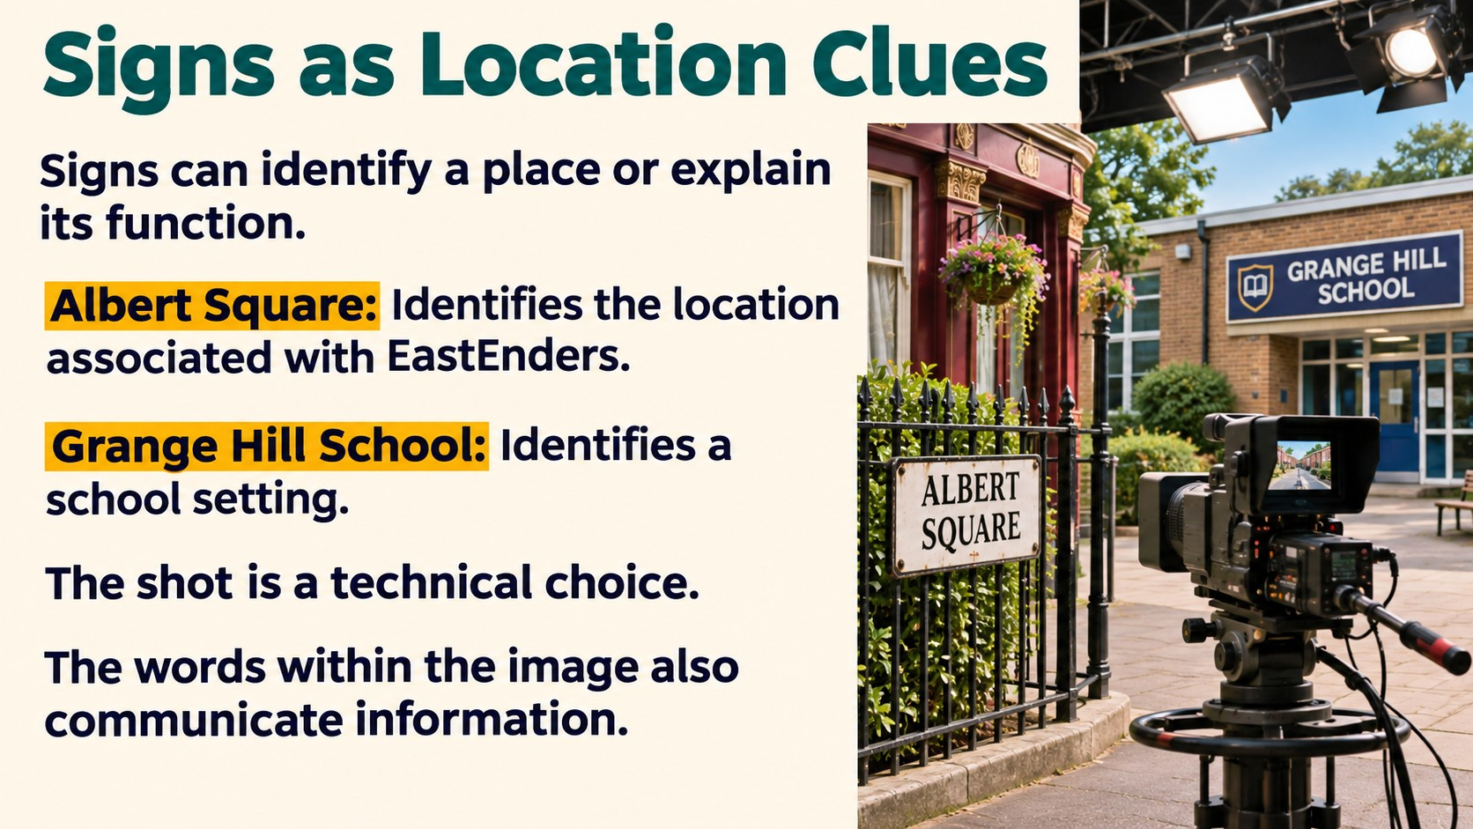
Notes:
Source: GCSE Media Studies for AQA, Heinemann (2004), uploaded as Year 11 Media Design.pdf, printed pages 34–39. Classroom adaptation. Generated imagery is illustrative, including historical scenes and programme examples. UK digital television date corrected to 1998: https://publications.parliament.uk/pa/cm200506/cmselect/cmcumeds/650/5121308.htm. Peak-time hours and programme openings refer to historical examples.

Slide 16
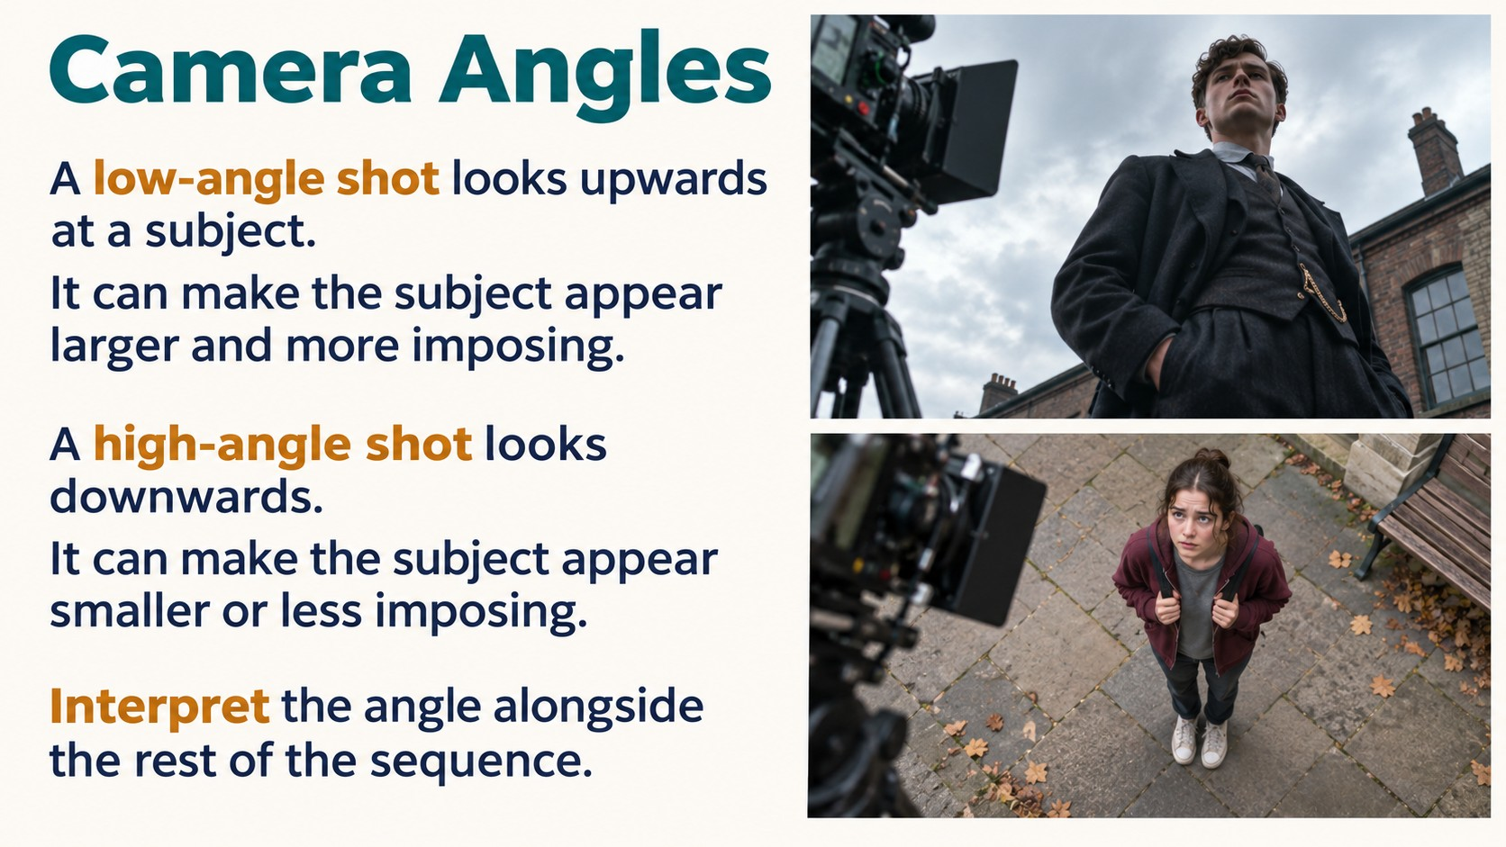
Notes:
Source: GCSE Media Studies for AQA, Heinemann (2004), uploaded as Year 11 Media Design.pdf, printed pages 34–39. Classroom adaptation. Generated imagery is illustrative, including historical scenes and programme examples. UK digital television date corrected to 1998: https://publications.parliament.uk/pa/cm200506/cmselect/cmcumeds/650/5121308.htm. Peak-time hours and programme openings refer to historical examples.

Slide 17
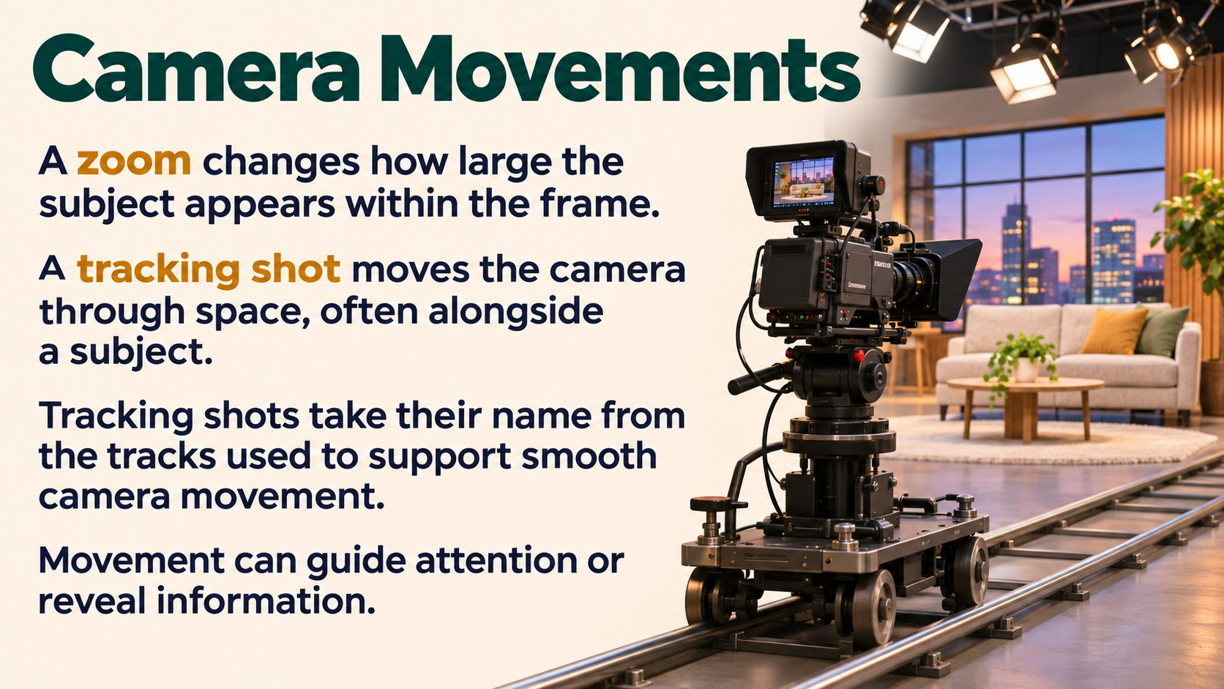
Notes:
Source: GCSE Media Studies for AQA, Heinemann (2004), uploaded as Year 11 Media Design.pdf, printed pages 34–39. Classroom adaptation. Generated imagery is illustrative, including historical scenes and programme examples. UK digital television date corrected to 1998: https://publications.parliament.uk/pa/cm200506/cmselect/cmcumeds/650/5121308.htm. Peak-time hours and programme openings refer to historical examples.

Slide 18
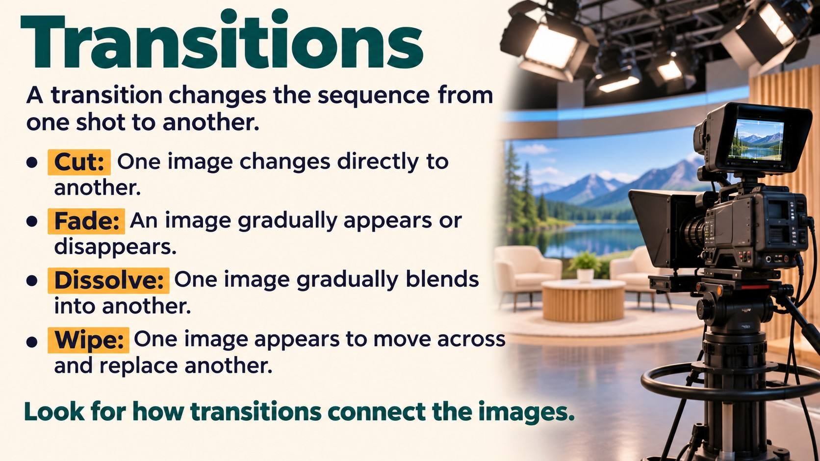
Notes:
Source: GCSE Media Studies for AQA, Heinemann (2004), uploaded as Year 11 Media Design.pdf, printed pages 34–39. Classroom adaptation. Generated imagery is illustrative, including historical scenes and programme examples. UK digital television date corrected to 1998: https://publications.parliament.uk/pa/cm200506/cmselect/cmcumeds/650/5121308.htm. Peak-time hours and programme openings refer to historical examples.

Slide 19
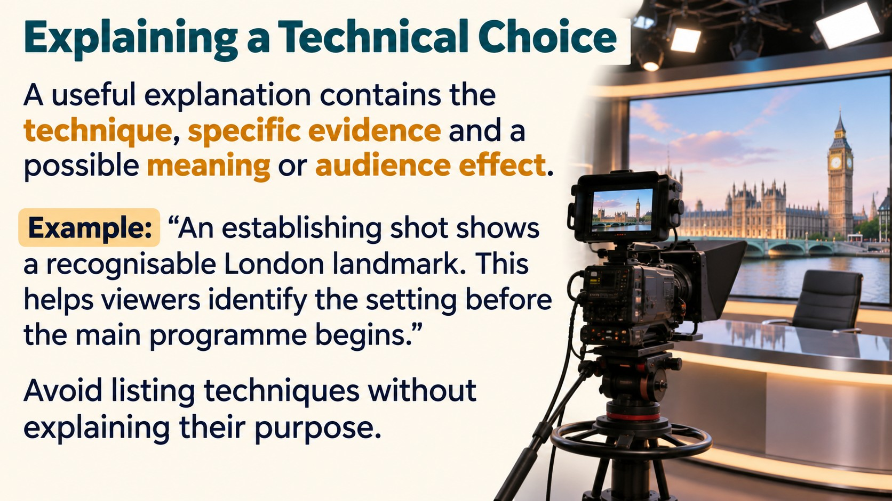
Notes:
Source: GCSE Media Studies for AQA, Heinemann (2004), uploaded as Year 11 Media Design.pdf, printed pages 34–39. Classroom adaptation. Generated imagery is illustrative, including historical scenes and programme examples. UK digital television date corrected to 1998: https://publications.parliament.uk/pa/cm200506/cmselect/cmcumeds/650/5121308.htm. Peak-time hours and programme openings refer to historical examples.

Slide 20
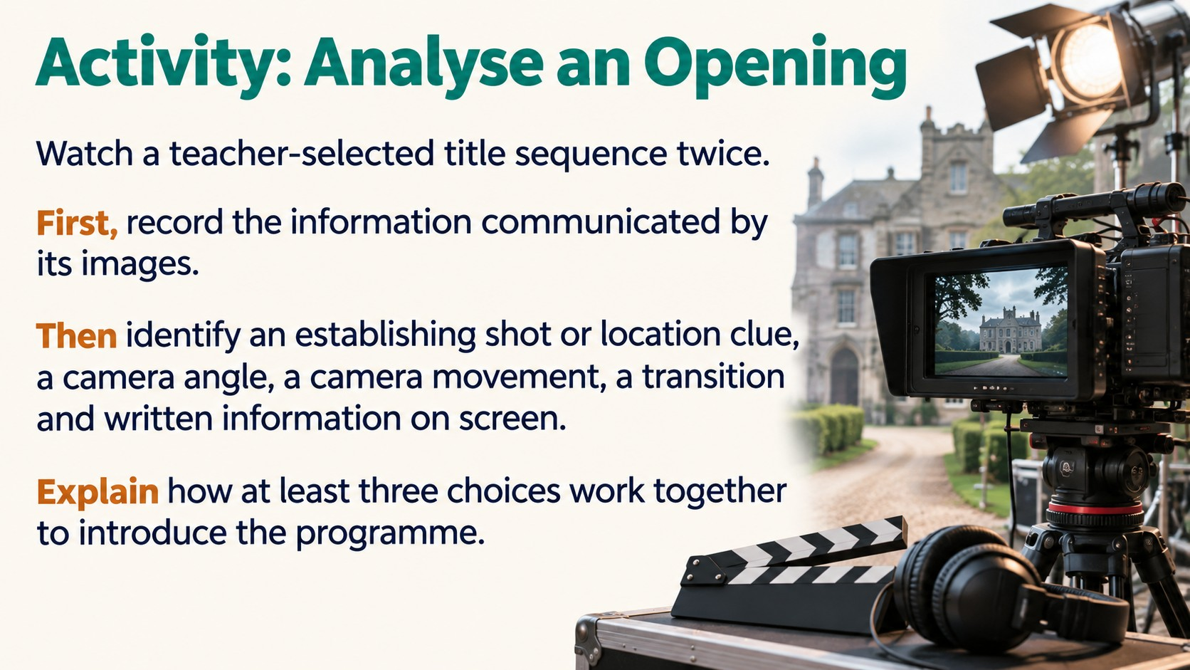
Notes:
Source: GCSE Media Studies for AQA, Heinemann (2004), uploaded as Year 11 Media Design.pdf, printed pages 34–39. Classroom adaptation. Generated imagery is illustrative, including historical scenes and programme examples. UK digital television date corrected to 1998: https://publications.parliament.uk/pa/cm200506/cmselect/cmcumeds/650/5121308.htm. Peak-time hours and programme openings refer to historical examples.

Slide 21
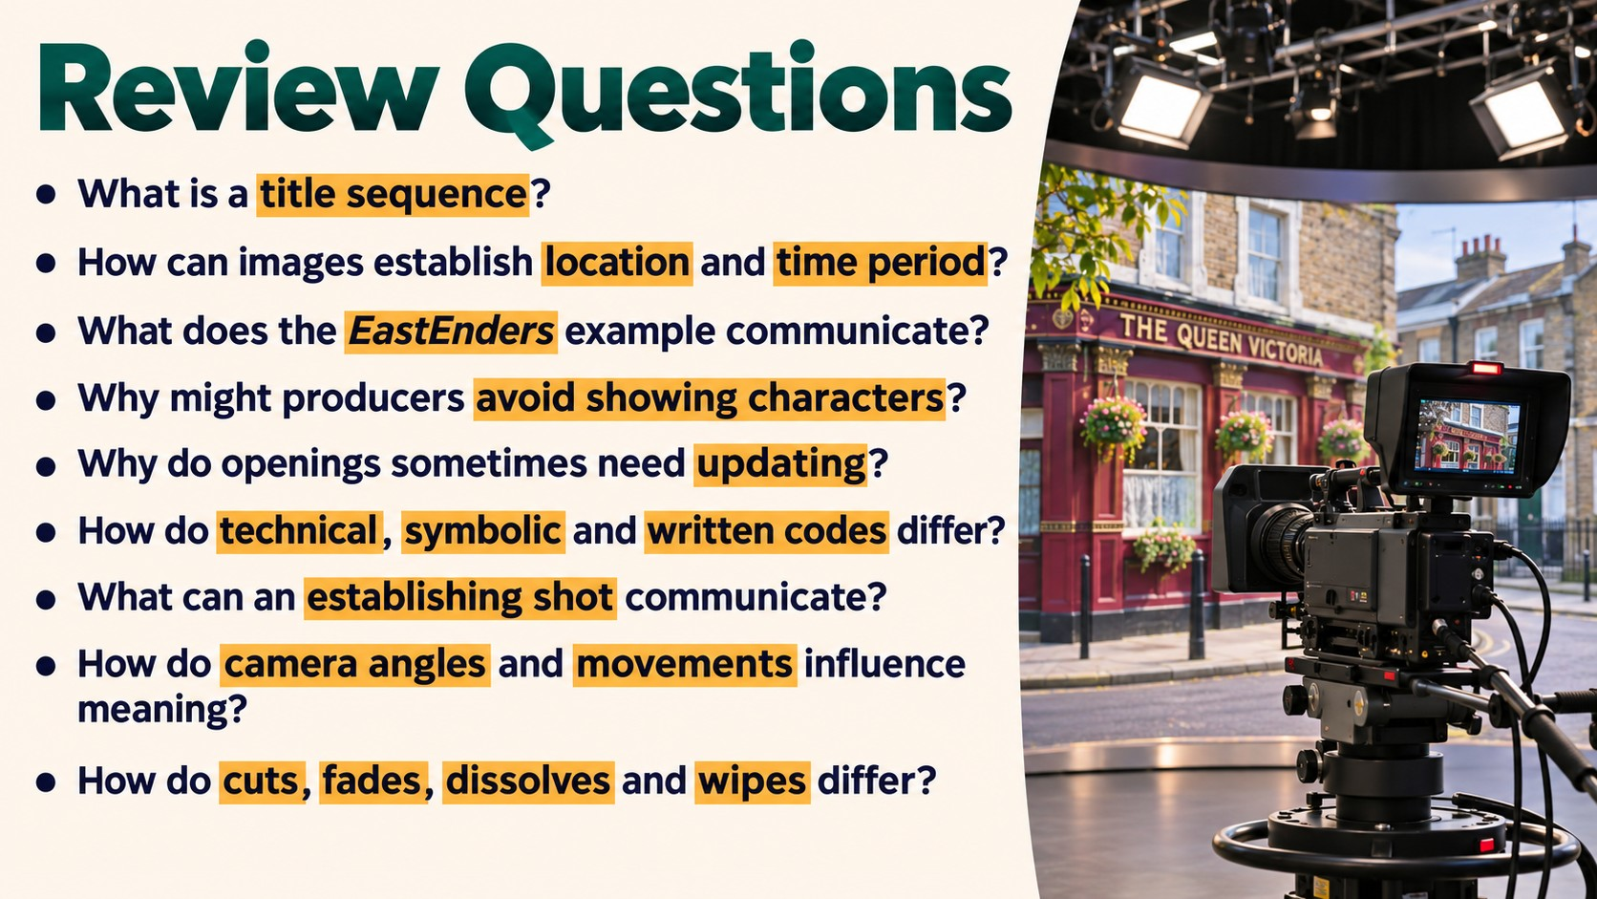
Notes:
Source: GCSE Media Studies for AQA, Heinemann (2004), uploaded as Year 11 Media Design.pdf, printed pages 34–39. Classroom adaptation. Generated imagery is illustrative, including historical scenes and programme examples. UK digital television date corrected to 1998: https://publications.parliament.uk/pa/cm200506/cmselect/cmcumeds/650/5121308.htm. Peak-time hours and programme openings refer to historical examples.

